Slide 1
A Prototype Hand Geometry-based Verification System
Anil K. Jain & Arun Ross Michigan State University
Sharath Pankanti IBM T.J. Watson Research Center
Presented By: Terence Henriod

Slide 2
Introduction
Goal: Identify individuals using hand geometries in a simple way
Sub-goal: increase discussion of hand geometry related pattern recognition
Verification vs. Identification
Verification: the problem of confirming a person’s claimed identity (authorization)
Identification: the problem of establishing a person’s identity
Biometric approaches are a popular approach to solving these problems
Motivation: There is relatively little literature on the use of hand geometry approaches to the Verification/Identification problem

Slide 3
Biometric Measurements
Biometrics: Physiological (anatomical) or behavioral traits
Good for use in person identification – biometric features are always with them
Commonly used biometrics for identification are fingerprints and iris/retinal patterns
Different measures have their strengths and limitations
Distinctiveness, user acceptability, technological cost/simplicity

Slide 4
Hand Geometry
Intuitively, the physical shape/dimensions of the hand
Various widths and thicknesses of fingers and palms were used
Simple to implement such a system
Low cost – a camera is the most expensive part
Low technology components
Convenient for users
Most people have hands that can easily be placed in/on a device
No need for frictional skin that fingerprint readers require
Easily integrated with other biometrics
Fingerprint reading, for example

Slide 5
Background
Hand Geometry system are not new – dating back to the ’70s
That being said, it is a neglected topic
Hand Geometry systems are non-invasive, simple to process
Most people have hands
Detailed features such as palm wrinkles need not be extracted
The features considered themselves are not particularly descriptive, but devising robust identification methods that use the features combined is a challenging and important pattern recognition problem

Slide 6
Apparatus
A simple board with some pegs to guide hand placement
A light source
A mirror
A camera for taking grayscale imaged
640 x 480 8-bit grayscale images
A GUI was used in experiments

Slide 7
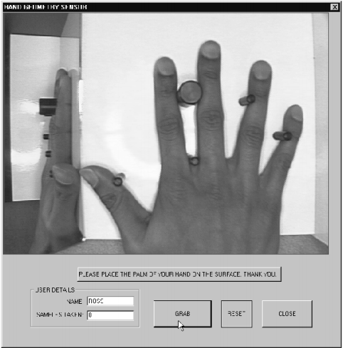
Pegs
Mirror

Slide 8
Procedure
Enrollment Phase
5 photos were taken, the hand was removed from the apparatus and then replaced between photos
Feature Values were simply averaged and the average feature vector was associated with the individual
Verification Phase
Two images are taken
Average feature vector is used for testing
Distance between test vector and target vector is thresholded to verify identity

Slide 9
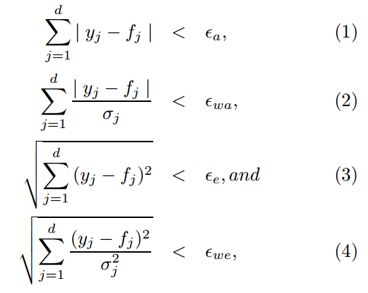
The four distance metrics used:
(1) Absolute Distance
(2) Weighted Absolute distance
(3) Euclidean Distance
(4) Weighted Euclidean Distance
Variance of features was used for weighting (large variance reduces the effect of larger distance); threshold values were not specified in the paper

Slide 10
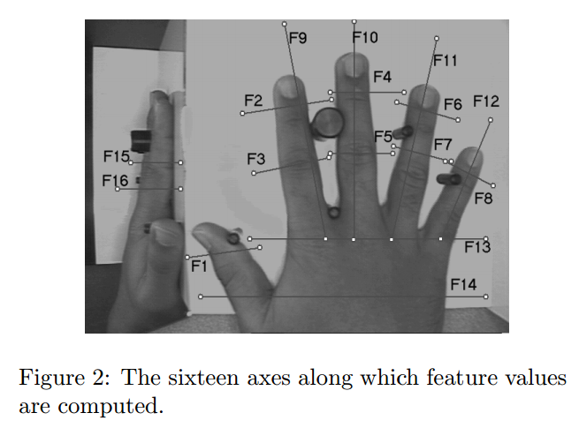
Features Used
Various thicknesses and widths of fingers and the palm were used

Slide 11
Chernoff Faces
A quick aside: A way to graphically represent multi-dimensional data
Invented by Herman Chernoff
Cartoon faces are used on the premise that humans can easily recognize differences in human faces
Different features of the face correspond to measurements of different features
Eye size and eyebrow slant have been found to carry significant weight
Mapping of experiment features to face fetures should be done with care
Source: http://en.wikipedia.org/wiki/Chernoff_face

Slide 12
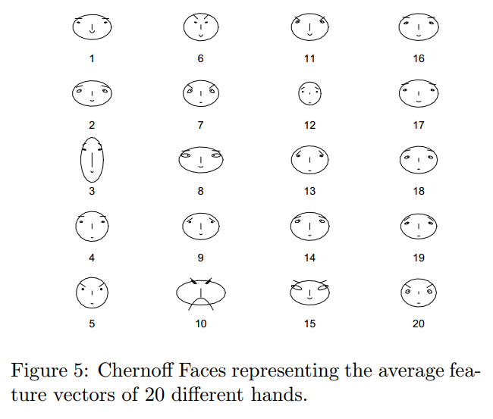
20 of the 50 users enrolled in the study’s database

Slide 13
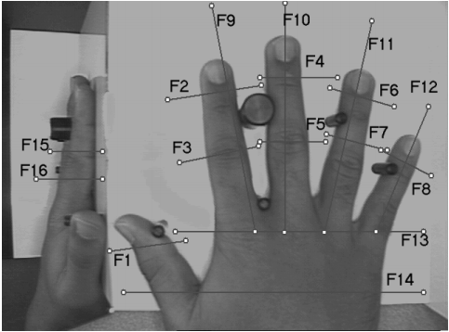

Experiment Feature | Face Feature | Experiment Feature | Face Feature
1 | Area of Face | 9 | Angle of Eyes
2 | Shape of Face | 10 | Shape of Eyes
3 | Length of Nose | 11 | Width of Eyes
4 | Location of Mouth | 12 | Location and Width of Pupil
5 | Curve of smile | 13 | Location of Eyebrows
6 | Width of Mouth | 14 | Angle of Eyebrows
7 | Location of Eyes | 15 | Width of Eyebrows
8 | Separation of Eyes | 16 | Not Included

Slide 14
Feature Extraction
This is where more advanced math came into play
A sort of edge detection strategy was used to measure the dimensions
Starting with a fixed length axis in the image, the gray values of the pixels were used to determine the desired biometric measurement

Slide 15
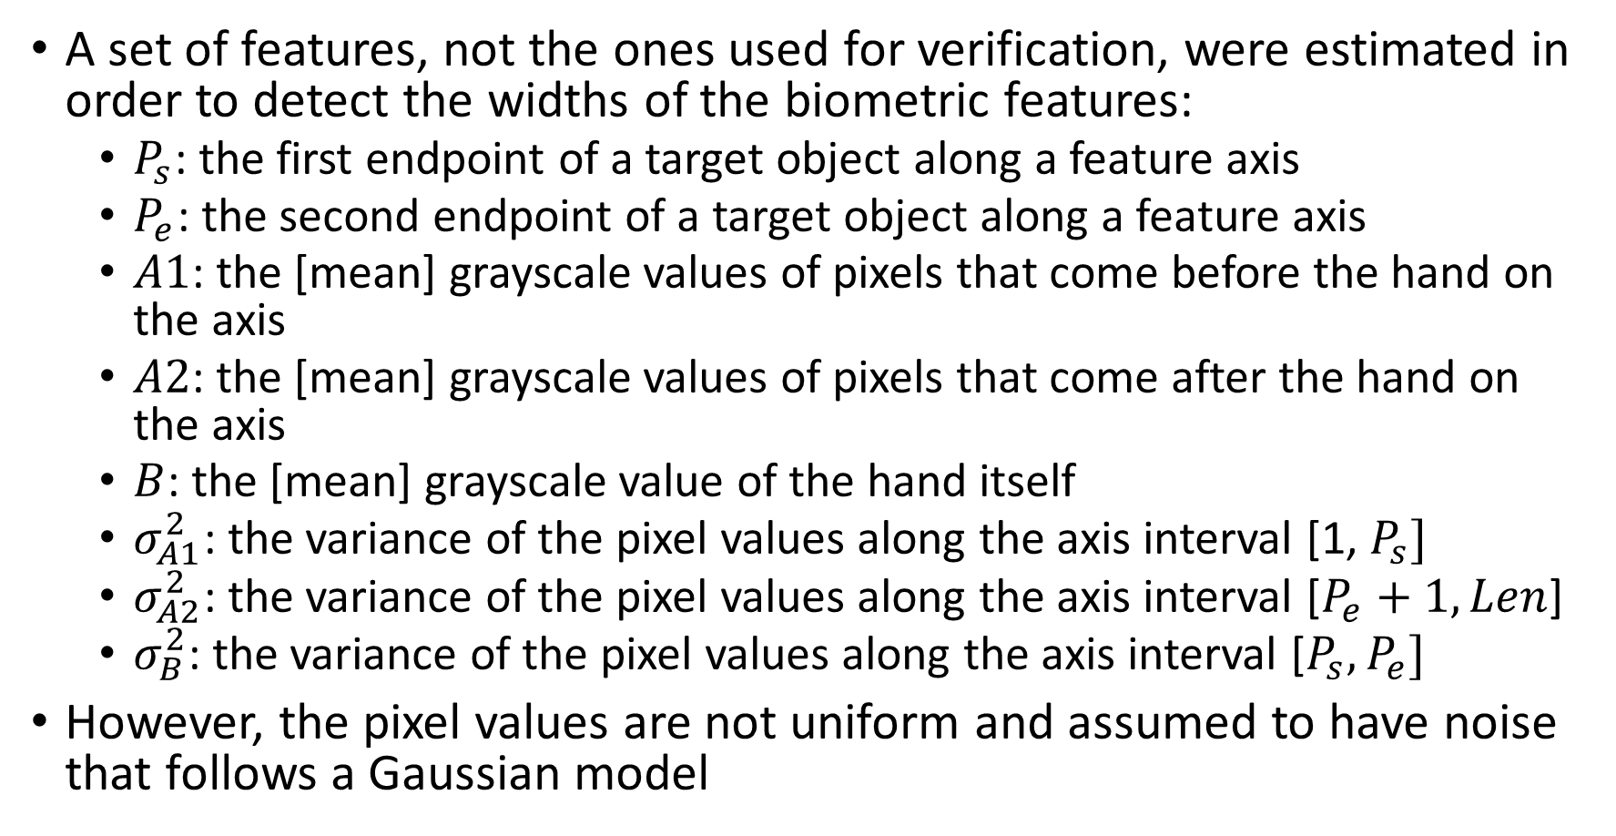
A set of features, not the ones used for verification, were estimated in order to detect the widths of the biometric features:
$P_{s}$: the first endpoint of a target object along a feature axis
$P_{e}$: the second endpoint of a target object along a feature axis
$A1$: the [mean] grayscale values of pixels that come before the hand on the axis
$A2$: the [mean] grayscale values of pixels that come after the hand on the axis
$B$: the [mean] grayscale value of the hand itself
$σ_{A1}^{2}$: the variance of the pixel values along the axis interval [1, $P_{s}]$
$σ_{A2}^{2}$: the variance of the pixel values along the axis interval [$P_{e}+1, Len$]
$σ_{B}^{2}$: the variance of the pixel values along the axis interval [$P_{s},P_{e}]$
However, the pixel values are not uniform and assumed to have noise that follows a Gaussian model

Slide 16
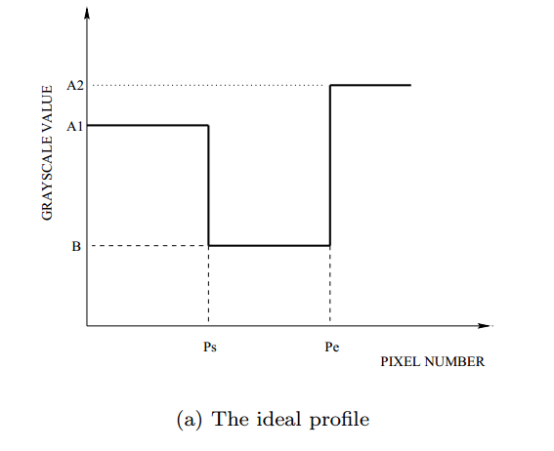
Len

Slide 17
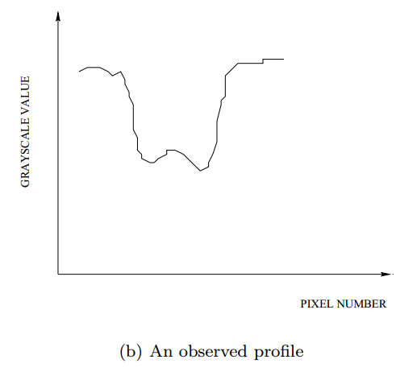
A1
A2
B
1
Ps
Pe
Len

Slide 18
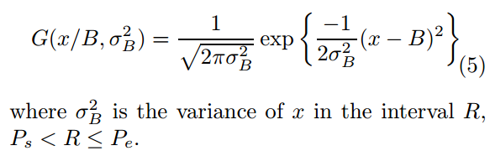
Hand colored pixels can then be assumed to be of the distribution:
Pixels can reasonably be assumed to be independent due to the lack of shadows

Slide 19
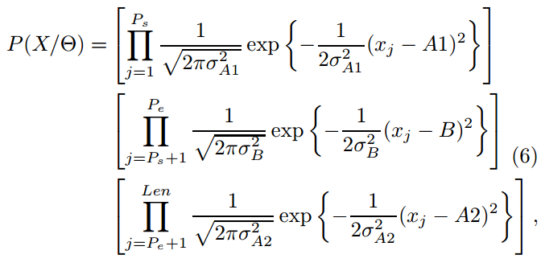
This gives the pdf:
Reminder:
1
Ps
Pe
Len
A1
B
A2

Slide 20
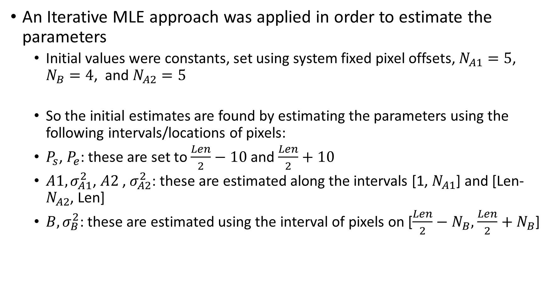
An Iterative MLE approach was applied in order to estimate the parameters
Initial values were constants, set using system fixed pixel offsets, $N_{A1}=5$, $N_{B}=4$, and $N_{A2}=5$
So the initial estimates are found by estimating the parameters using the following intervals/locations of pixels:
$P_{s}$, $P_{e}$: these are set to $\frac{Len}{2}−10$ and $\frac{Len}{2}+10$
$A1,σ_{A1}^{2}$, $A2$, $σ_{A2}^{2}$: these are estimated along the intervals [1, $N_{A1}$] and [Len-$N_{A2}$, Len]
$B,σ_{B}^{2}$: these are estimated using the interval of pixels on [$\frac{Len}{2}−N_{B},$ $\frac{Len}{2}+N_{B}$]
1
NA1
NB
Len/2
NB
NA2
Len
10
10
Ps
Pe
A1
B
A2

Slide 21
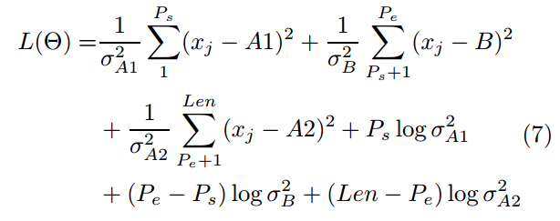
For completeness, the log-likelihood step:

Slide 22

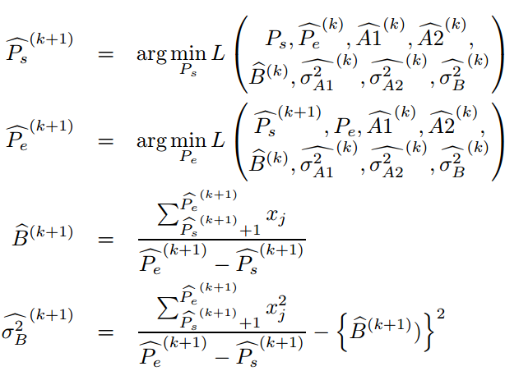
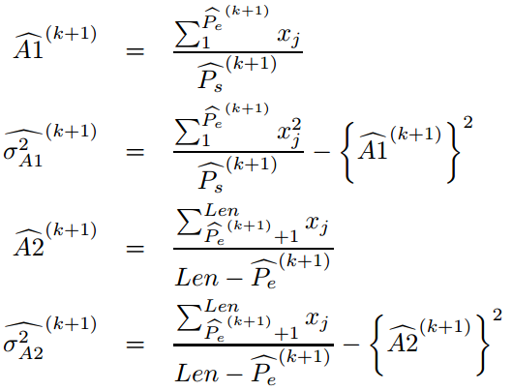
Finally, we have the equations for finding the (k+1)st estimate of each parameter given some observation
The paper doesn’t specify, but as with most iterative methods, it can be reasonably assumed that iterations halt when little to no improvement is gained by continuing iterations

Slide 23
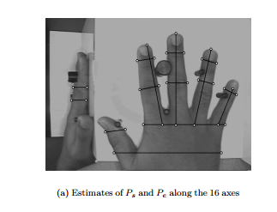

Slide 24
Experiment Results
Started with 50 users, 10 images each
2, 5 image sessions with different background lighting in each session, as described in the enrollment phase
Only 360 images were kept due to faulty usage of the apparatus
See next slide
The best performance was achieved using weighted Euclidean distance (and accompanying threshold values)

Slide 25
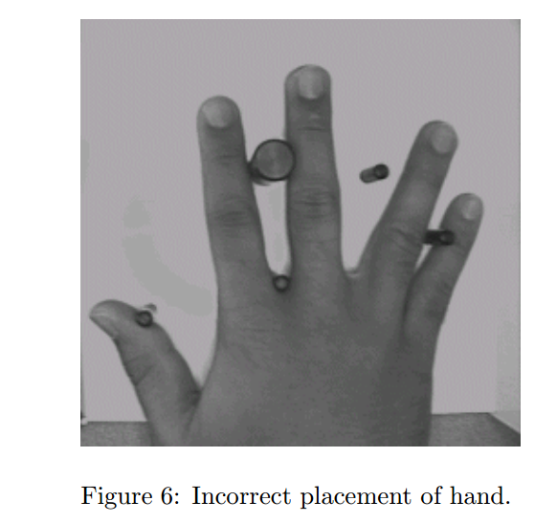

Slide 26
Entries in the database were compared against all other entries for testing purposes
Hit: The minimum distance between the test vector and any database entry for that individual is below the exclusion threshold
False Acceptance: The minimum distance between a test vector and a data base entry for a non-matching individual is the impostor score. If the impostor score is below the exclusion threshold, then this is a false acceptance

Slide 27
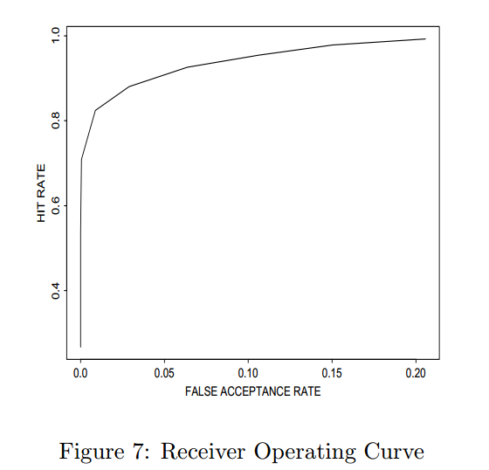
Thresholds used were not mentioned

Slide 28
Future Work/System Improvements
Improve user interface (to prevent bad hand placements)
Add other features, such as skin color
The paper claims it is unknown if anyone has attempted this
Try using non-visible spectrum light
Add 2-D hand features
Integrate with other biometrics
Expand database

Slide 29
My Conclusions
Not particularly “ground breaking”
Verification is rather limiting when compared with the power of identification
Requiring two images is not very convenient, and thus less likely to be “acceptable” to users
Paper did not clearly state many results or compare explored methods thoroughly
Was this more of a “toy?”

Slide 30
Idea was simple, if it could be implemented with better features/performance, this could be a good thing
The paper demonstrated an interesting approach for measuring objects in images
(Relatively) Simple mathematical methods made for an easy read, simple implementation concept

